Slide 1
Added Functionality Using Design Patterns
Christopher Ramirez, Justin Lee, Jene Rene, Precious Iheanacho

Slide 2
Discount Functionality
Preparation:
Update Database to include a discount table with attributes:
discountName: the name of the discount: VARCHAR(30)
discountCode: unique code used at checkout to apply discount to cart: VARCHAR(8)
active: status of the discount: BOOLEAN
fraction: percentage of product price being discounted from product. Value range is (0,1], 1 being the full price of the product for BOGO type discounts. : DOUBLE
Update product table to include an additional attribute `discount`.
Add a foreign key constraint to linking the discount table to the products table through the discount code.
Create classes:
DiscountBean class
DiscountService class
DiscountServiceImpl class
Concrete Discount classes

Slide 3
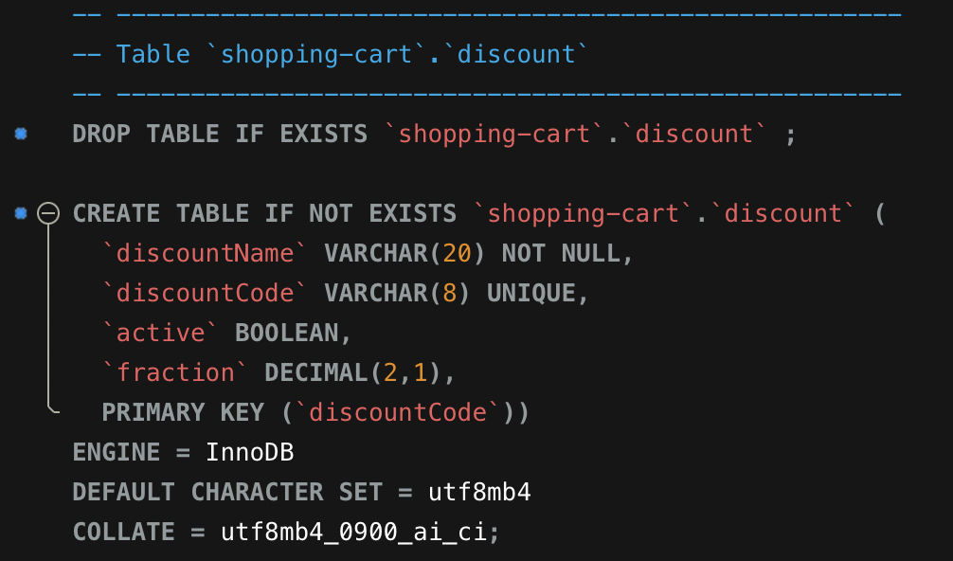
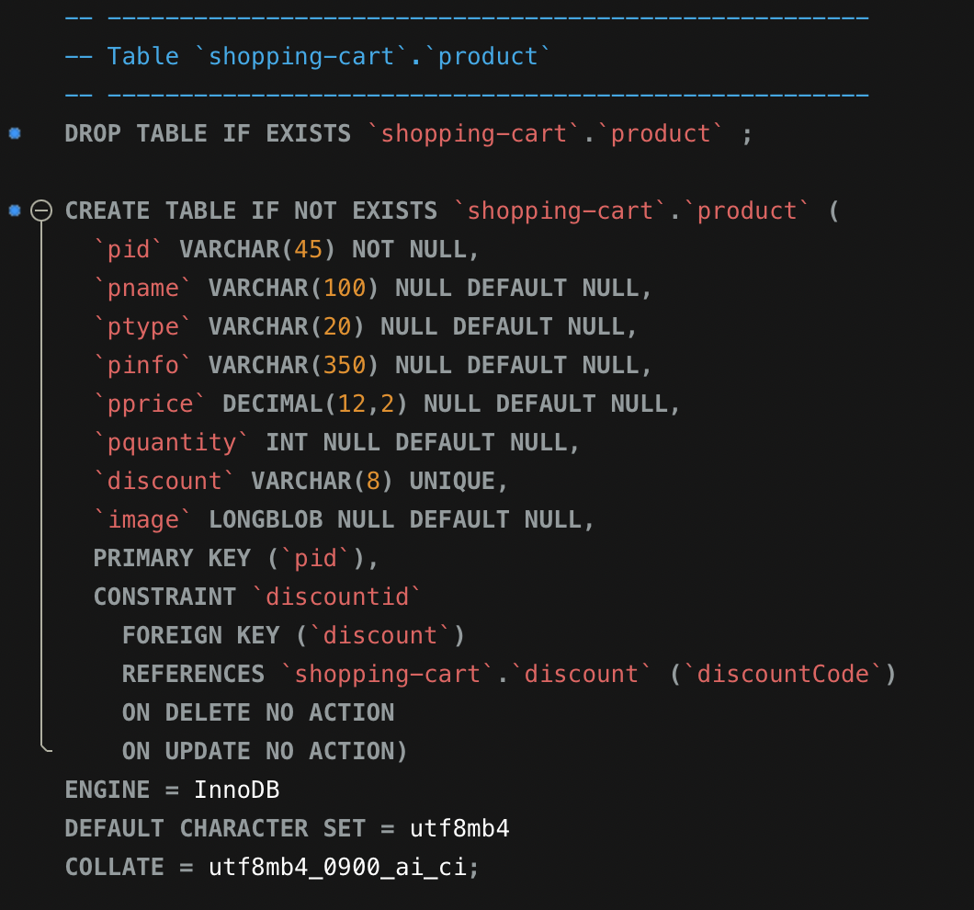
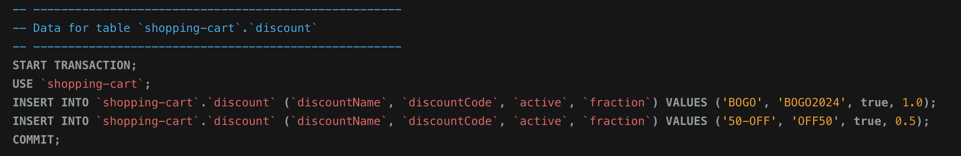
Database Adjustments

Slide 4
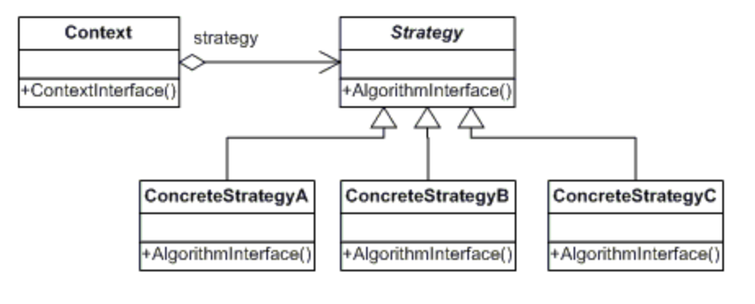
Strategy Pattern
DIscountService
DiscountServiceImp
+applyDiscount()
+applyDiscount()
DIscountBOGO
DiscountPercentage
DiscountShipping
+applyDiscount()
+applyDiscount()
+applyDiscount()

Slide 5
SOLID
Our approach maintains SOLID principles in the following ways:
Single Responsibility Principle – The discount classes have one single responsibility; apply a discount to the cart.
Open/Closed Principle – Our approach is dynamic and expansive. New discounts can be added as concrete classes stemming from the DiscountServiceImp Interface.
Liskov Substitution – each concrete class has a method for applying the appropriate discount to the cart. Therefore, each concrete class can substitute the base class DiscountServiceImp.
Interface Segregation Principle – our DiscountServiceImp Interface has one single responsibility.
Dependency Inversion Principle – classes are depending on abstraction instead of concretion.

Slide 6
Add new products to inventory
Add attribute SKU (stock keeping unit): A unique stock-keeping unit code for the product, which is often used to identify the product in inventory systems.
The Singleton Design Pattern is used for the Inventory class to ensure only one instance of the inventory system exists.
The Factory Method could be used to create different types of products.
Create classes:
Product- contains basic attributes for the product.
InventoryManager - The singleton class responsible for managing the inventory.
ProductFactory- Factory design pattern is used through ProductFactory to encapsulate the creation of product objects.
ProductRepository- Defines the operations that can be performed on product data. This includes adding, getting, and updating products.
InMemoryProductRepository- Stores products in an in-memory Map for quick access and modification.

Slide 7
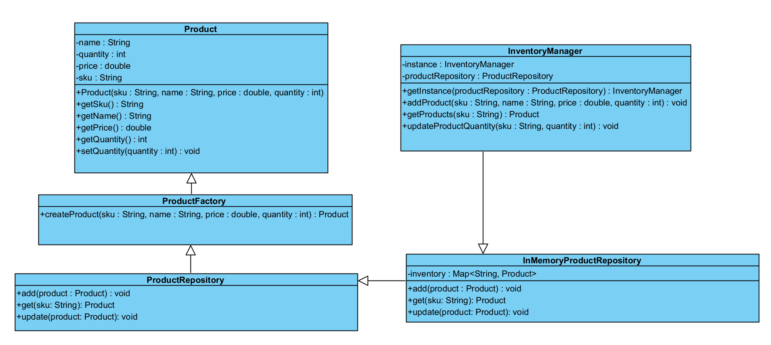
Singleton/Factory Pattern

Slide 8
SOLID
Our approach maintains SOLID principles in the following ways:
Single Responsibility Principle - Each class is focused on a single task.
Open/Closed Principle- New product repository types can be added without modifying existing code. The system is extendable.
Liskov Substitution- You can swap out InMemoryProductRepository with another implementation without affecting InventoryManager.
Interface Segregation Principle- The ProductRepository interface only includes methods relevant to product management (add, get, update).
Dependency Inversion Principle- InventoryManager depends on the ProductRepository interface, allowing flexibility to use different repository implementations.

